Slide 1

HUMAN ACTIVITY PATTERN DISCOVERY
Using Smartphone Sensor Data
A Comparative Clustering Analysis
UCI HAR Dataset • 10,299 Samples • 561 Sensor Features • 6 Activity Labels

Slide 2

Project Overview
What this analysis set out to discover
Smartphones carry accelerometers and gyroscopes that continuously record motion. The UCI Human Activity Recognition (HAR) dataset captures 561 engineered signal features per observation, each labeled with one of six activities performed by 30 volunteers. This project asks an unsupervised question: if the activity labels were hidden, would clustering algorithms rediscover six distinct behavioral groups on their own — or something simpler?
10,299
561
Total Samples
Sensor Features
6
30
1
Explore and validate the merged train/test dataset
Activity Labels
Subjects
2
Reduce dimensionality via PCA and Random Forest feature importance
3
Apply KMeans, Hierarchical, and Gaussian Mixture clustering
4
Validate clusters internally (Silhouette, DBI, CHI) and externally (ARI, NMI)
5
Interpret what the discovered clusters reveal about human activity
Human Activity Pattern Discovery — Clustering Analysis
2

Slide 3

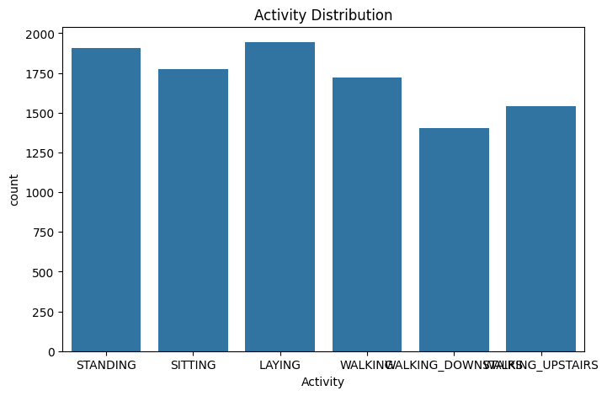
Dataset Quality & Activity Distribution
Train + test sets merged into a single 10,299-row dataset
0
Missing Values
0
Duplicate Rows
563
Total Columns
44.2 MB
Memory Footprint
Activity counts: LAYING 1,944 · STANDING 1,906 · SITTING 1,777 · WALKING 1,722 · WALKING_UPSTAIRS 1,544 · WALKING_DOWNSTAIRS 1,406
Human Activity Pattern Discovery — Clustering Analysis
3

Slide 4

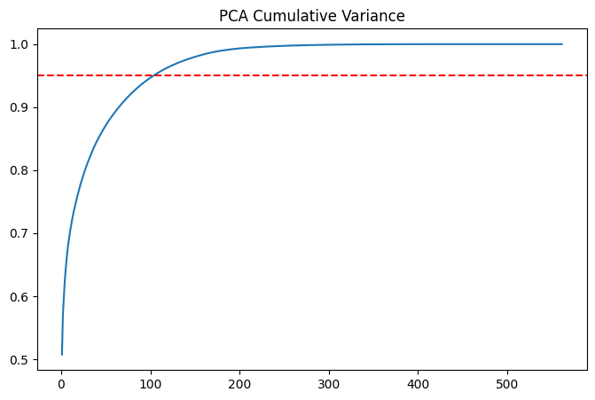
Dimensionality Reduction with PCA
Compressing 561 correlated sensor features down to their essential signal
561 → 105
components needed to retain 95% of the dataset's variance — a ~81% reduction in dimensionality.
The red dashed line marks the 95% variance threshold. The steep early rise confirms heavy redundancy among the 561 raw features (many are derived from the same X/Y/Z accelerometer and gyroscope signals), so a much smaller set of components captures nearly all the information.
Human Activity Pattern Discovery — Clustering Analysis
4

Slide 5

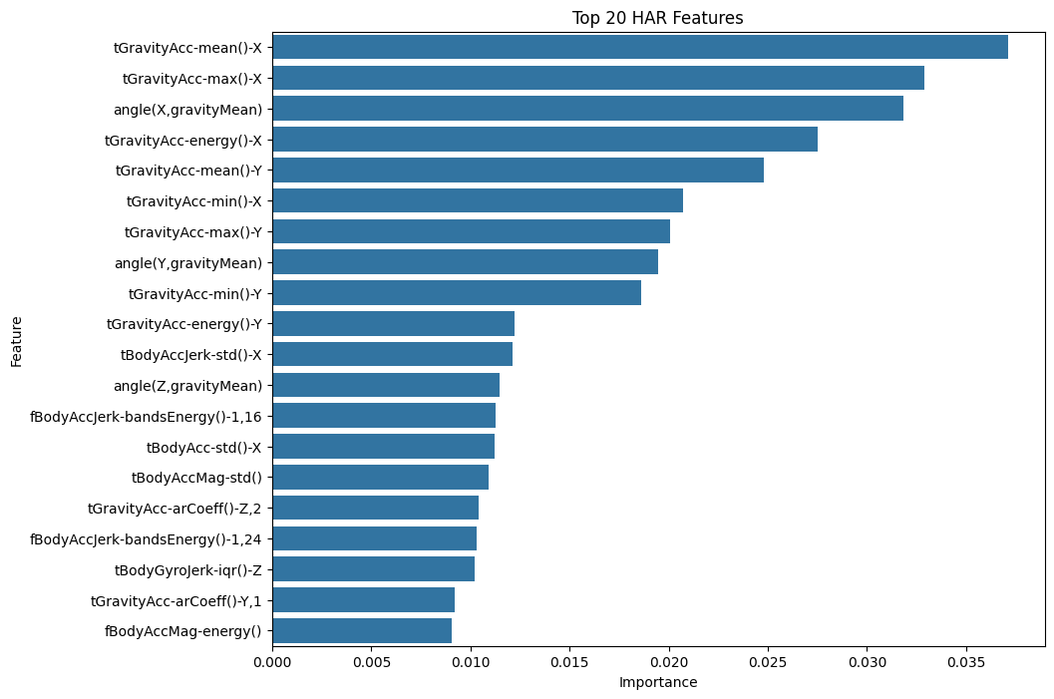
Feature Importance (Random Forest)
Identifying which sensor signals matter most for distinguishing activities
Feature | Importance
tGravityAcc-mean()-X | 0.0371
tGravityAcc-max()-X | 0.0329
angle(X,gravityMean) | 0.0318
tGravityAcc-energy()-X | 0.0275
tGravityAcc-mean()-Y | 0.0248
tGravityAcc-min()-X | 0.0207
Gravity-axis features dominate the top of the ranking — these capture device/body orientation and are highly diagnostic of posture (sitting vs. standing vs. laying vs. walking).
Human Activity Pattern Discovery — Clustering Analysis
6

Slide 6

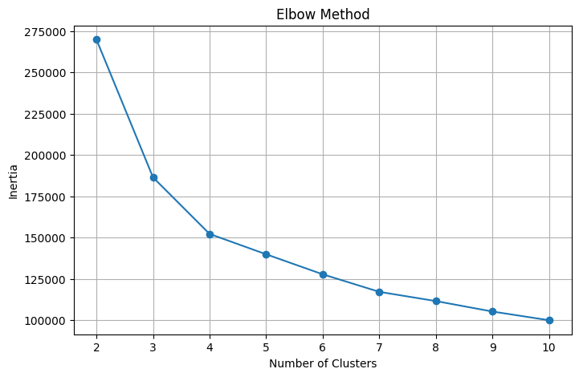
Choosing the Number of Clusters: Elbow Method
Top 50 most important features selected and standardized before clustering
50
top-ranked features carried forward into clustering (down from 561 raw / 105 PCA components)
The inertia (within-cluster sum of squares) drops sharply from k=2 to k=4, then flattens. The visible bend around k=3–4 suggests diminishing returns from adding more clusters beyond that point — consistent with the silhouette analysis on the next slide.
Human Activity Pattern Discovery — Clustering Analysis
7

Slide 7
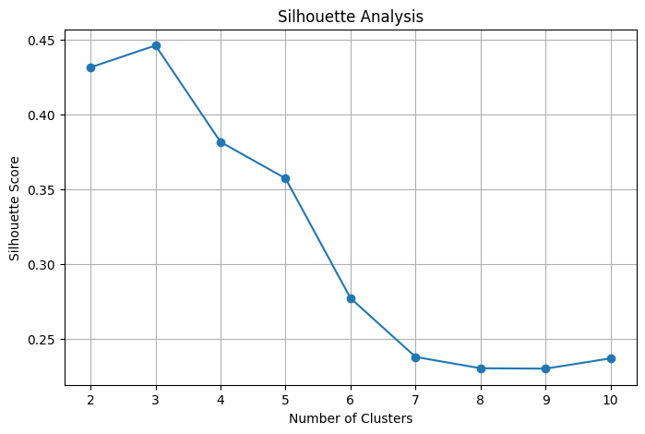
Silhouette Analysis
Testing k = 2 through 10 to find the best-separated clustering solution
k | Silhouette
2 | 0.4313
3 | 0.4459
4 | 0.3815
5 | 0.3572
6 | 0.2773
7 – 10 | 0.23 – 0.24
k = 3 produces the highest silhouette score (0.4459) of any tested value — higher even than k = 6, the number of true activity labels. This is the first quantitative signal that the natural cluster structure is coarser than the original labeling.
Human Activity Pattern Discovery — Clustering Analysis
8

Slide 8

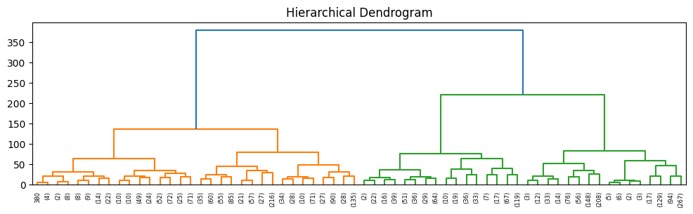
Hierarchical Clustering
Ward-linkage dendrogram on a 3,000-sample subset, truncated to 5 levels
The dendrogram structure visually supports a small number of major branches near the top of the tree, reinforcing the case for a low cluster count. However, as the algorithm comparison on the following slides shows, Agglomerative clustering performed poorly by quantitative metrics on this high-dimensional feature space relative to KMeans and GMM.
Human Activity Pattern Discovery — Clustering Analysis
9

Slide 9

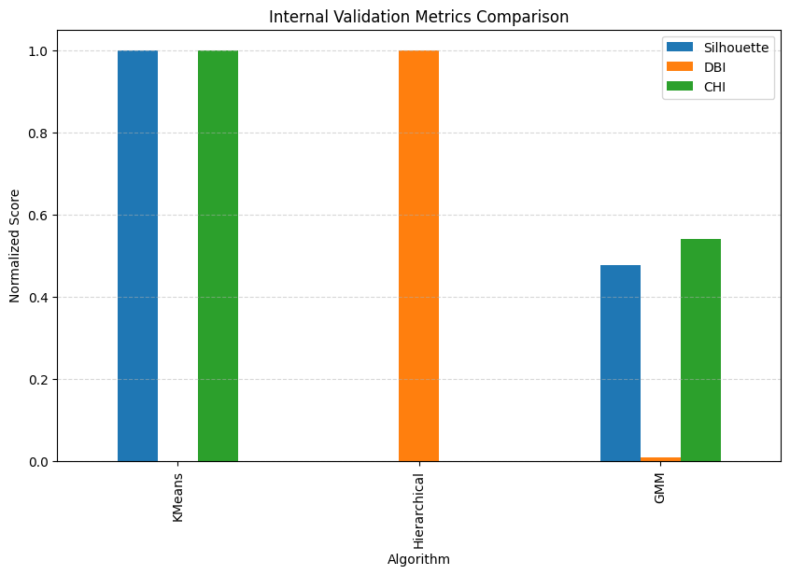
Algorithm Comparison: Internal Validation
KMeans vs. Hierarchical vs. Gaussian Mixture Model (k = 3)
Algorithm | Silhouette ↑ | Davies-Bouldin ↓ | Calinski-Harabasz ↑
KMeans | 0.4459 | 0.8894 | 9,067.70
Hierarchical | -0.0036 | 98.6592 | 0.24
GMM | 0.2102 | 1.6432 | 4,901.45
KMeans wins decisively on all three internal metrics: highest silhouette and Calinski-Harabasz, lowest Davies-Bouldin. Hierarchical clustering performs poorly here, likely due to the high-dimensional, near-uniform density of the standardized feature space.
Human Activity Pattern Discovery — Clustering Analysis
10

Slide 10
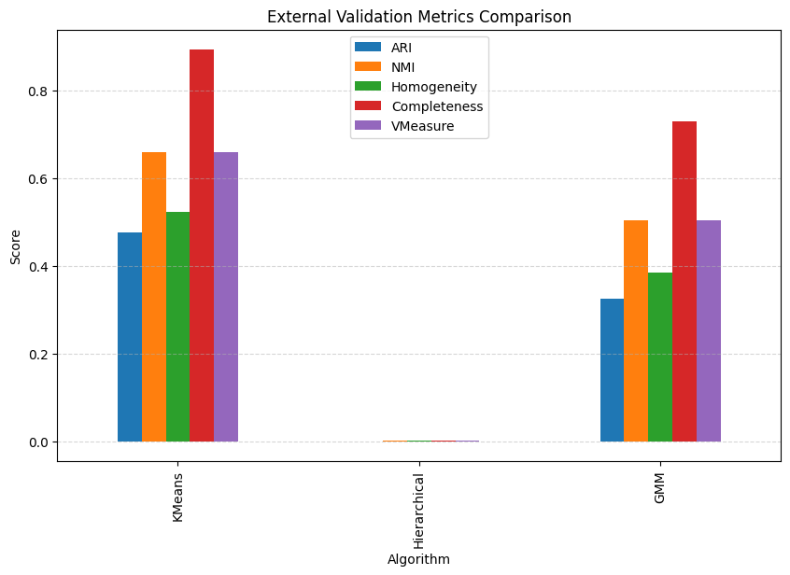
Algorithm Comparison: External Validation
Agreement between cluster assignments and the true activity labels
Algorithm | ARI | NMI | Homog. | Complete. | V-Measure
KMeans | 0.4765 | 0.6597 | 0.5224 | 0.8947 | 0.6597
Hierarchical | -0.0001 | 0.0009 | 0.0008 | 0.0013 | 0.0009
GMM | 0.3255 | 0.5034 | 0.3843 | 0.7293 | 0.5034
Completeness is consistently the highest external score for every algorithm (0.89 for KMeans) — meaning each true activity tends to fall within a single cluster. Homogeneity is comparatively lower, telling us each cluster contains more than one true activity. This is the quantitative fingerprint of activities merging into broader clusters, not clusters splitting activities apart.
Human Activity Pattern Discovery — Clustering Analysis
11

Slide 11
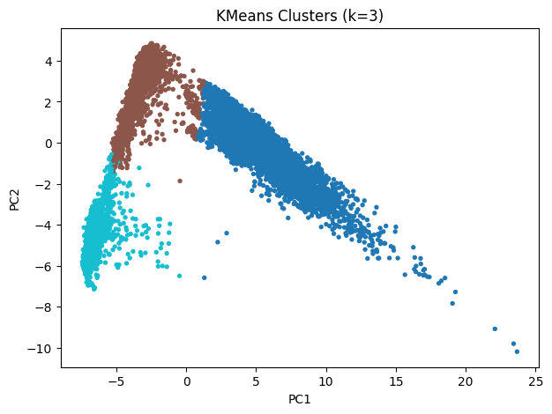
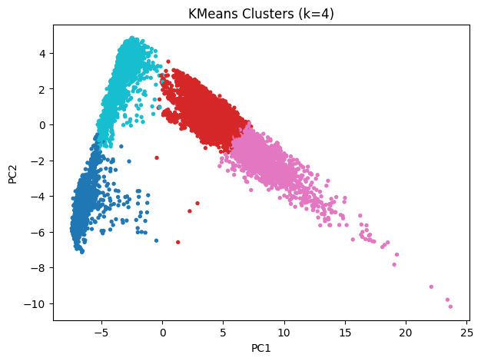
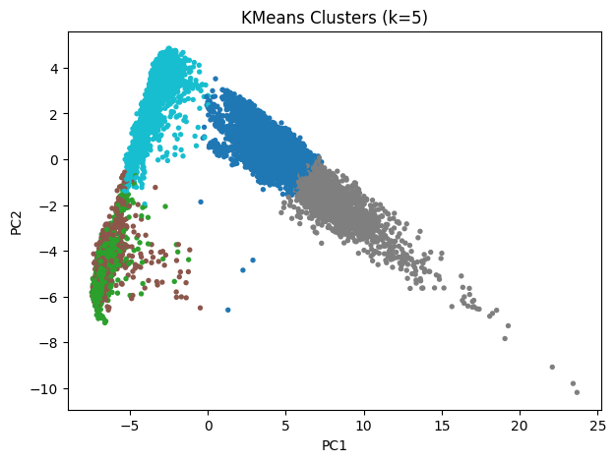
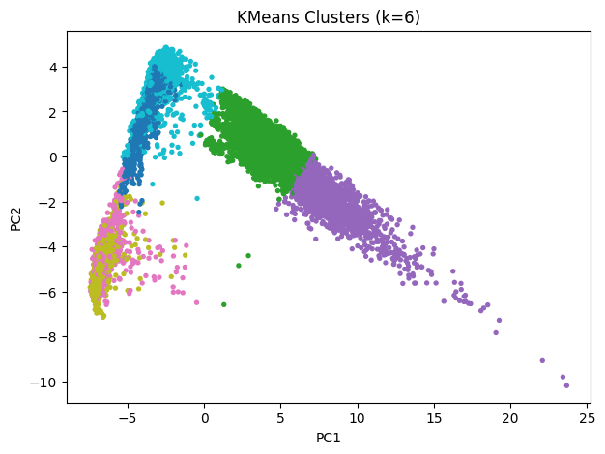
KMeans Clusters Across k Values
PCA (2-component) projections for k = 3, 4, 5, and 6
k = 3
k = 4
k = 5
k = 6
Human Activity Pattern Discovery — Clustering Analysis
12

Slide 12
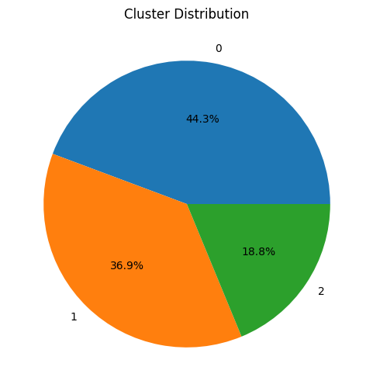
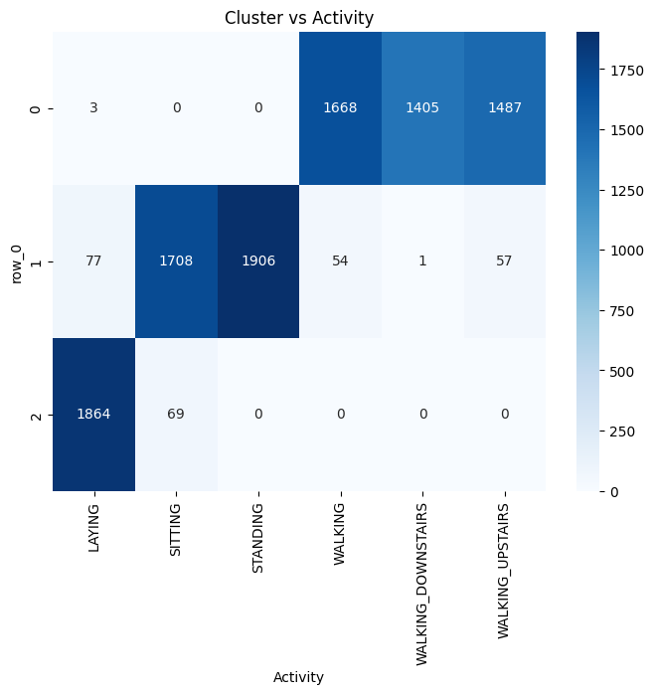
Cluster Composition at k = 3
How the chosen KMeans solution distributes samples and aligns with activities
Cluster Sizes
C0
4,563
C1
3,803
C2
1,933
Purity
0.528
Human Activity Pattern Discovery — Clustering Analysis
13

Slide 13
Key Finding: Six Activities, Three Natural Clusters
The most important result of this project
Clustering is unsupervised — the algorithm never sees the six activity labels, it only groups observations by similarity. Since k = 3 produced the highest silhouette score of any value tested (including k = 6), the data itself indicates that the six labeled activities are not equally separable in feature space, and naturally collapse into three broader behavioral categories.
Cluster | Walking | Upstairs | Downstairs | Sitting | Standing | Laying
C0 — Dynamic | 40% | 35% | 25% | 0% | 0% | 0%
C1 — Upright/Static | 0% | 0% | 0% | 55% | 45% | 0%
C2 — Resting | 0% | 0% | 0% | 0% | 0% | 100%
Dynamic Activities
Static Upright
Resting
Walking, Walking Upstairs, Walking Downstairs merge — all involve continuous, repetitive locomotion.
Sitting and Standing merge — both are still, upright postures hard to distinguish from accelerometer/gyroscope signal alone.
Laying remains fully separate — its orientation relative to gravity is unmistakably different from all other postures.
Human Activity Pattern Discovery — Clustering Analysis
14

Slide 14

Conclusion
Although the Human Activity Recognition dataset contains six labeled activities, silhouette analysis indicated that the optimal number of clusters was three (Silhouette Score = 0.4459). This suggests that the sensor measurements naturally form three broader behavioral groups rather than six completely distinct classes.
Walking-related activities (walking, walking upstairs, walking downstairs) grouped together as dynamic activities; sitting and standing grouped as static upright activities; and laying formed a separate resting cluster. The clustering process captured the intrinsic structure of the data, while the six-class labeling represents a finer-grained supervised categorization.
KMeans (k=3) was the strongest performer overall — highest Silhouette (0.4459), lowest Davies-Bouldin (0.8894), and highest external agreement (ARI 0.4765) among the three algorithms compared.
Human Activity Pattern Discovery — Clustering Analysis
15

